Slide 1
FALLARM PROJECT
Database – Sheela JEEVAN
Socket Server and Simulator – Abuzer DOGAN
Web Server – Venkat RAGHAVVARMA
Web Application – Burhan COKCA
Tests – Ashish RAYMONDS
Deployment and Last Words – Burhan COKCA

Slide 2
Database – MYSQL
We created a Fallarm schema in MYSQL database for the Fallarm project application.
This database schema is designed to stored all the various data required by this application.
It facilitates the setting up of the data by the application and retrieving the same when requested by the application.
The application components that access the database are the Web Server and the Socket program.
Socket uses JDBC and Web Server uses node-mysql (pure javascript client implementing the Mysql protocol)

Slide 3
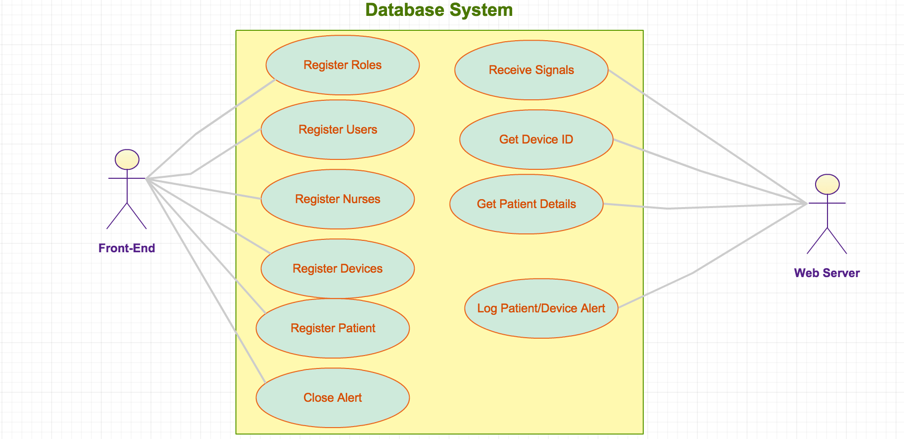
USE CASE DIAGRAM

Slide 4
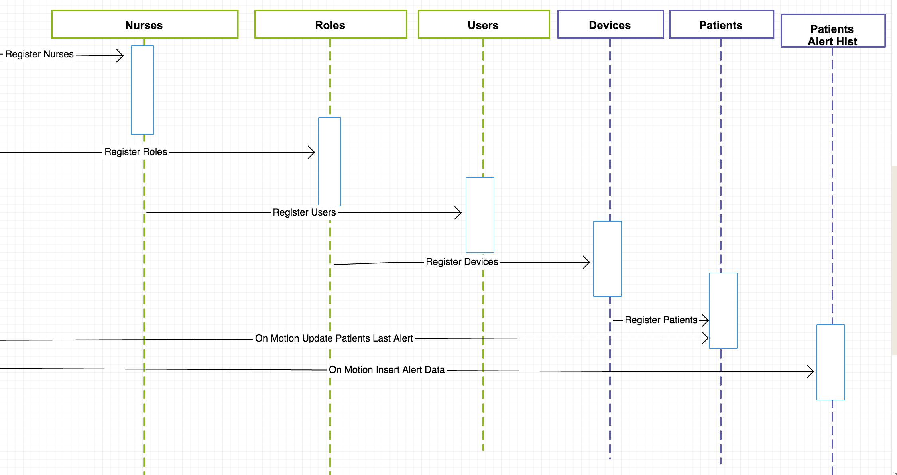
SEQUENCE DIAGRAM

Slide 5
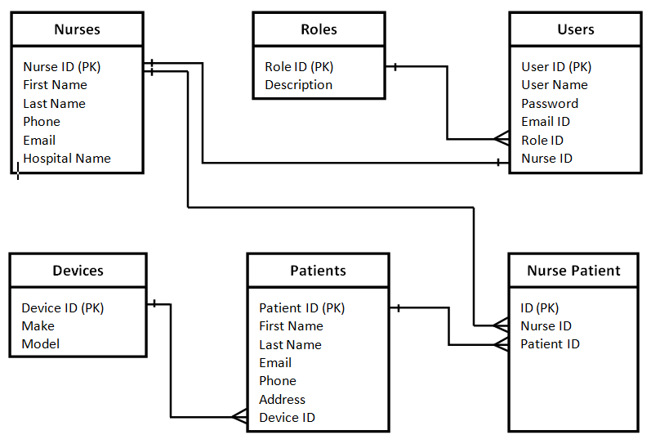
E-R DIAGRAM

Slide 6
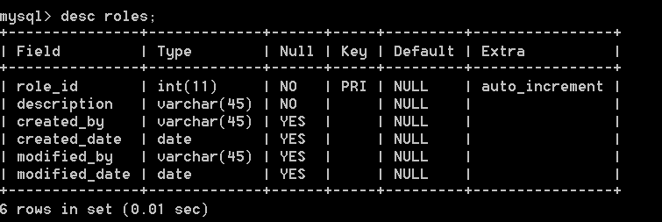
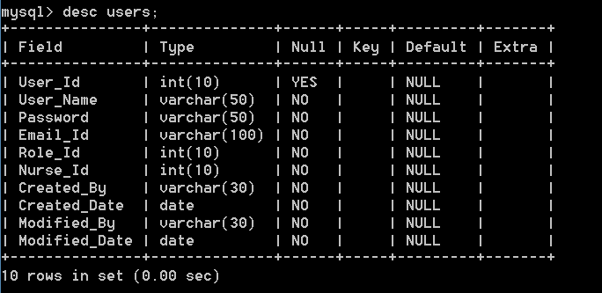
Tables created in database
ROLES
2. USERS

Slide 7
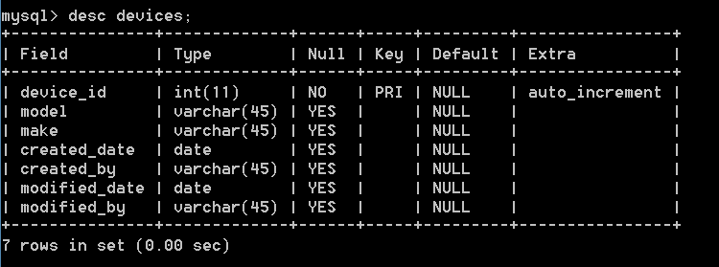
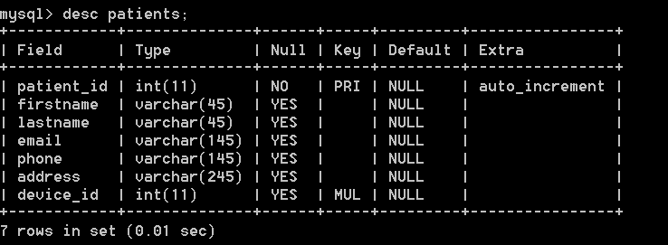
3. DEVICES
PATIENTS

Slide 8
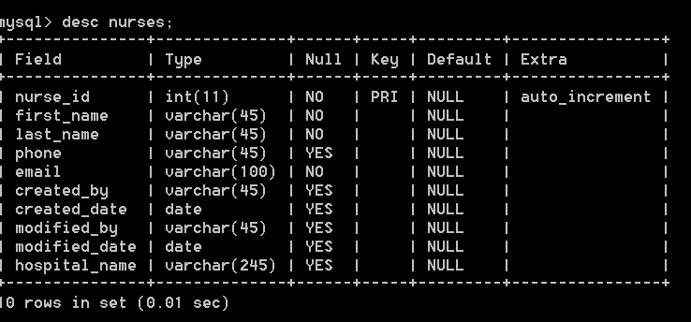
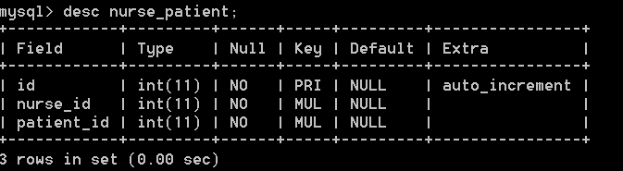
NURSES
ALTER TABLE NURSES ADD CONSTRAINT NURSES_PK PRIMARY KEY (Nurse_Id);
NURSE_PATIENT

Slide 9
Socket Server and Simulator
SOCKET SERVER
GUI ( INSTEAD OF DEVICE WE USE SIMULATOR)
TCP/IP
DB-JDBC
MAIL SERVER-SMTP

Slide 10
Socket Server
MAIL SERVER
DB
SMTP
JDBC
SOCKET SERVER
GUI
TCP/IP

Slide 11
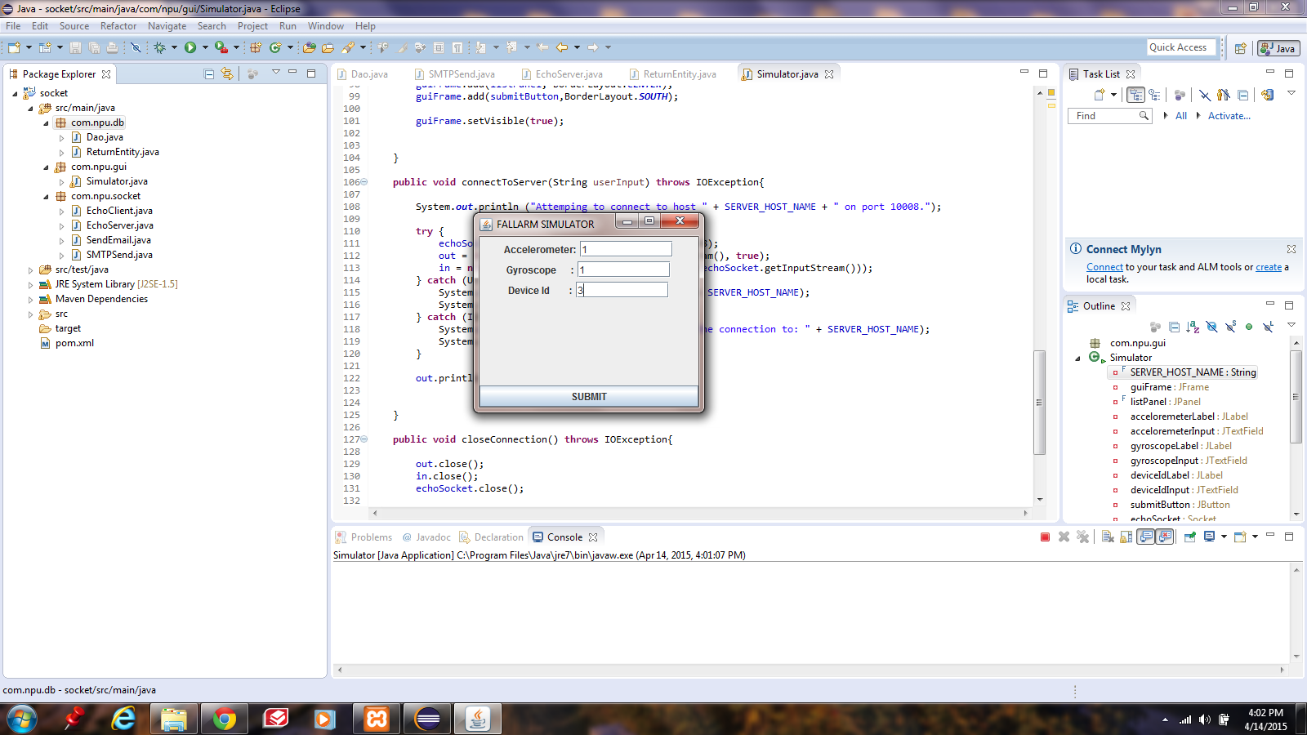

Slide 12
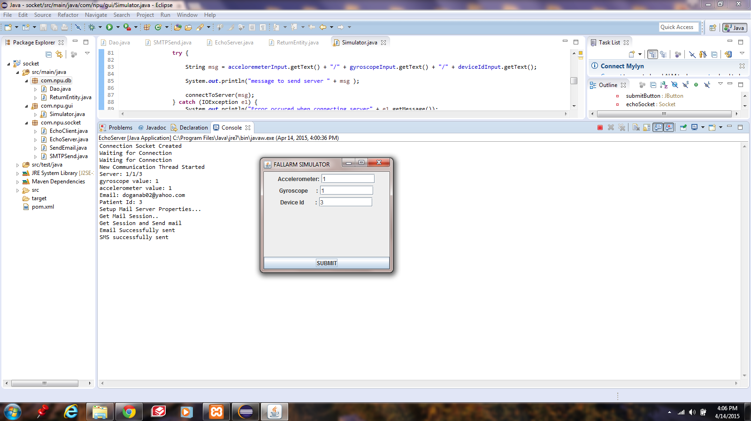

Slide 13
Web Server - NodeJS
A JavaScript runtime environment running Google Chrome’s V8 engine aka a server-side solution for JS
Compiles JS, making it really fast.
Runs over the command line.
Designed for high concurrency.
Without threads or new processes.
Never blocks, not even for I/O.
Uses the CommonJS framework

Slide 14
What can you do with Node.js ?
You can create an HTTP server and print ‘hello world’ on the browser in just 4 lines of JavaScript.
You can create a TCP server similar to HTTP server, in just 4 lines of JavaScript.
You can create a DNS server.
You can create a Static File Server.
You can create a Web Chat Application like GTalk in the browser.
Node.js can also be used for creating online games, collaboration tools or anything which sends updates to the user in real-time.

Slide 15
RESTFULL ARCHITECTURE
REST stands for Representational State Transfer
It is an architectural pattern for developing web services as opposed to a specification.
REST web services communicate over the HTTP specification, using HTTP vocabulary:
Methods (GET, POST, etc.)
HTTP URI syntax (paths, parameters, etc.)
Media types (xml, json, html, plain text, etc)
HTTP Response codes.

Slide 16
What we have done
We created a webserver, where clients are interacted to this server and server will give appropriate response .
Server will contain the files like
App.js which will setup , start and define routes for the server
DB.js will execute the common sql queries.
Member.js is the main file which will check the user name and password, update password, and also check the device id of patient and give response.
Config.js contains the credential information of host, port, database etc .
Other.js which will give the error information which is used if there is trouble with server.

Slide 17


Web App - AngularJS
Fallarm Web App

Slide 18
AngularJS
HTML enchanced for web apps
SPA(Single Page Application)
MVC Architecture
Fully Javascript
https://angularjs.org/
Other solutions: EmberJS, backboneJS and etc.

Slide 19
Twitter Bootstrap
Sleek, intuitive and powerful front-end framework for faster and easier development.
Bootstrap for Angular: AngularUI
Grid Style
Pre-ready components, colors and more

Slide 20
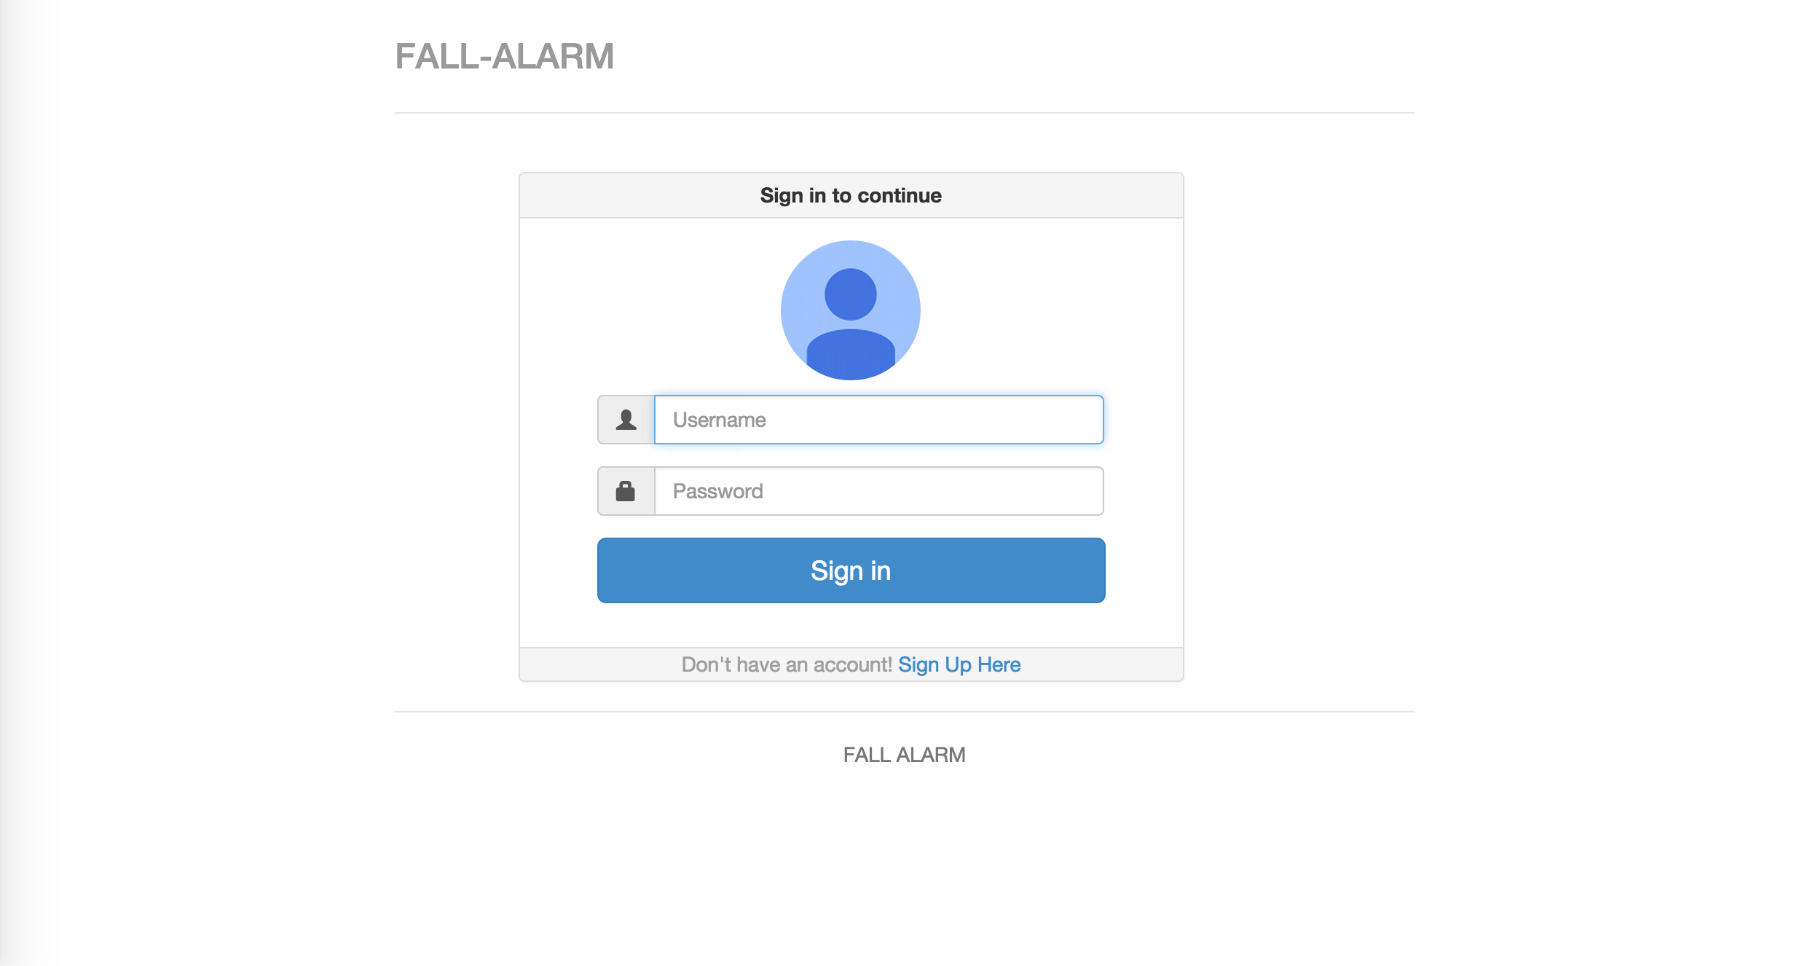
Screenshot - Login

Slide 21
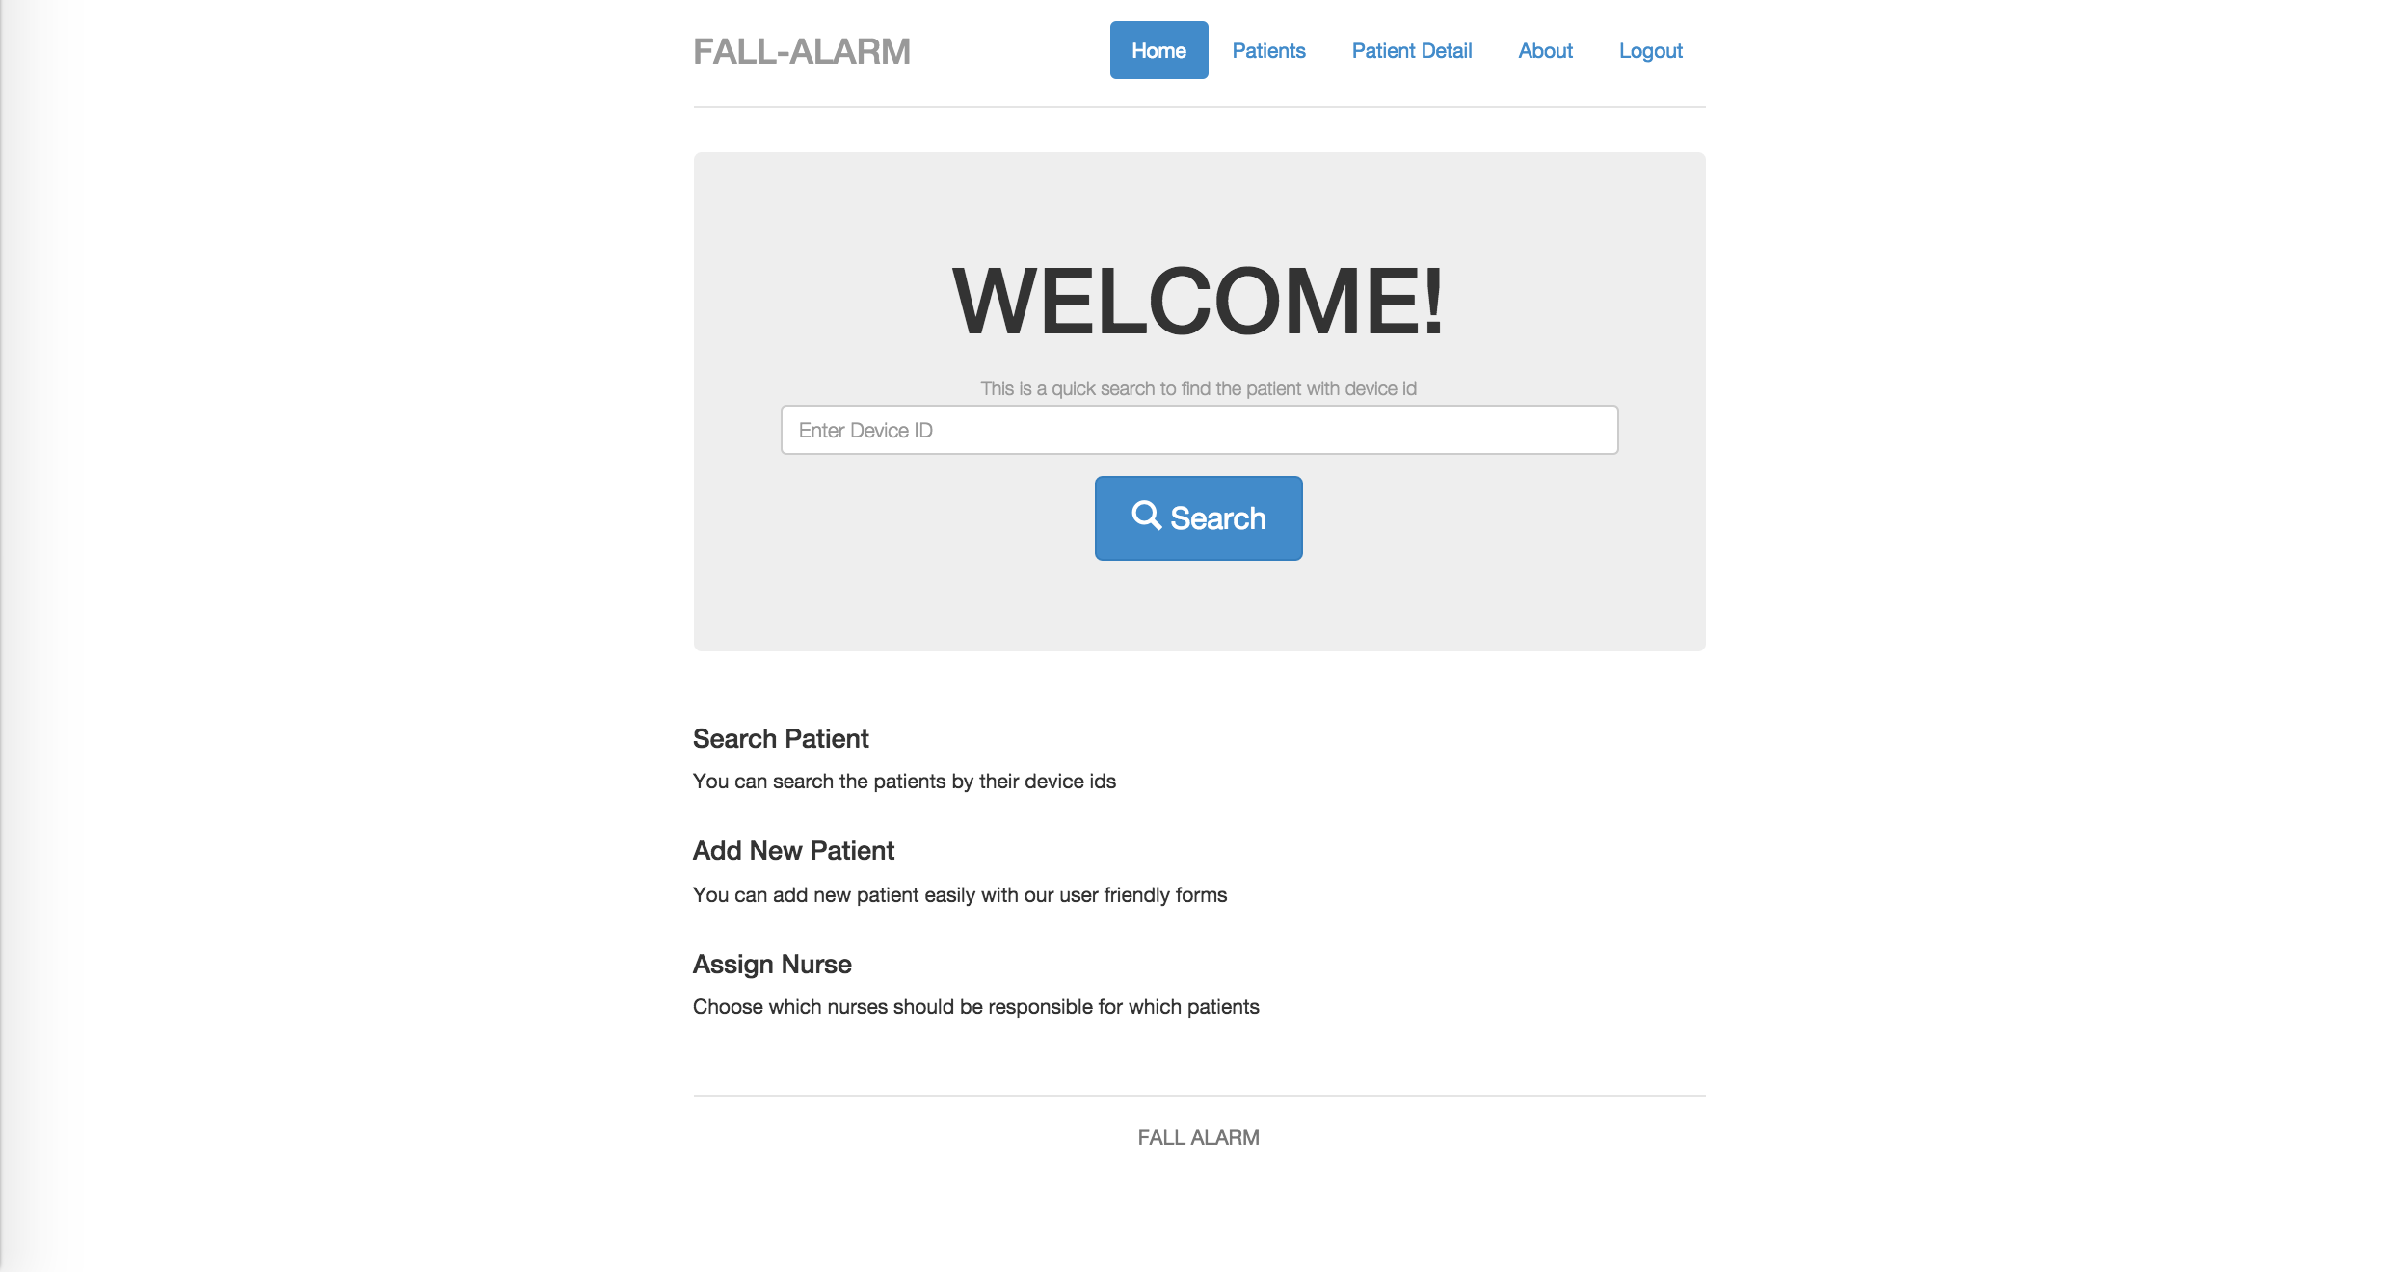
Screenshot – Main

Slide 22

Screenshot – Patient Detail

Slide 23

Deployment and Last Words

Slide 24
Deployment and Last Words
Cloud is new future.
Hardware is cheaper.
Amazon Web Services (AWS)
RDS (Relational Database Service)
EC2 (Elastic Compute Cloud)

Slide 25
Test and QA
Selenium Tests Screen Shots
JUnit

Slide 26
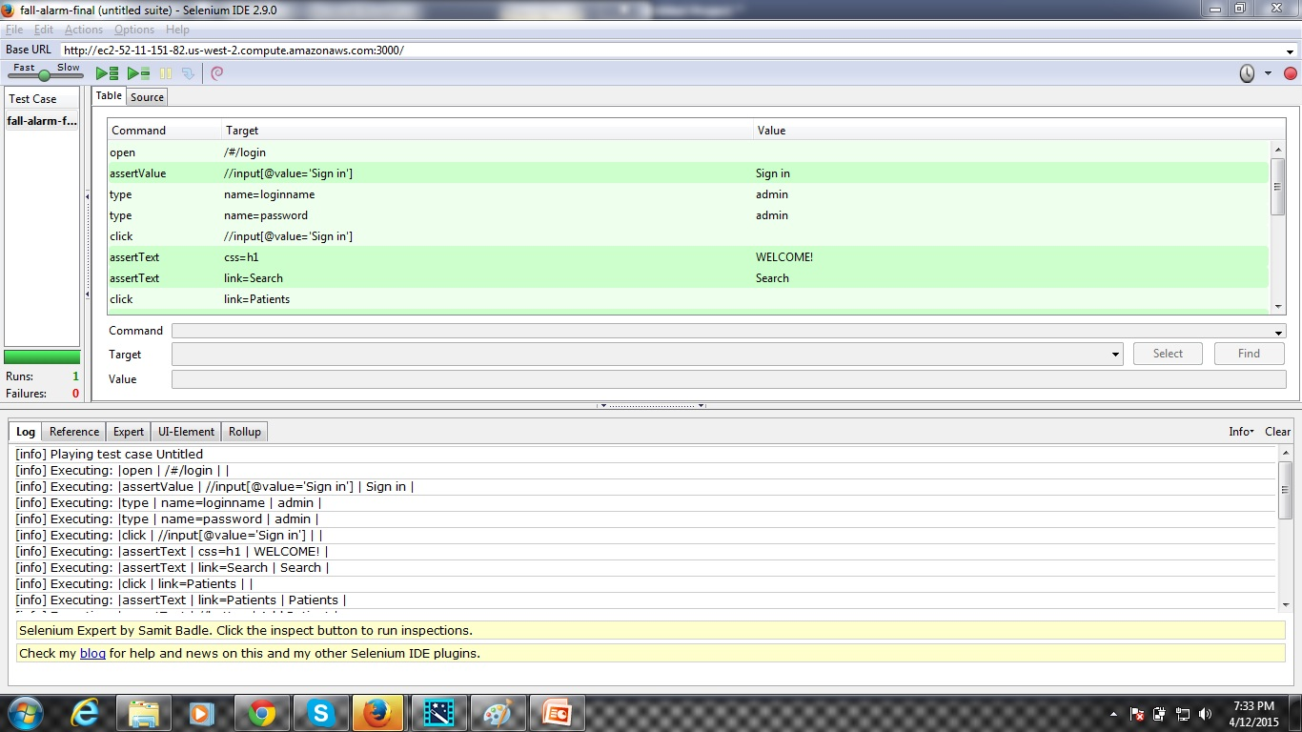

Slide 27
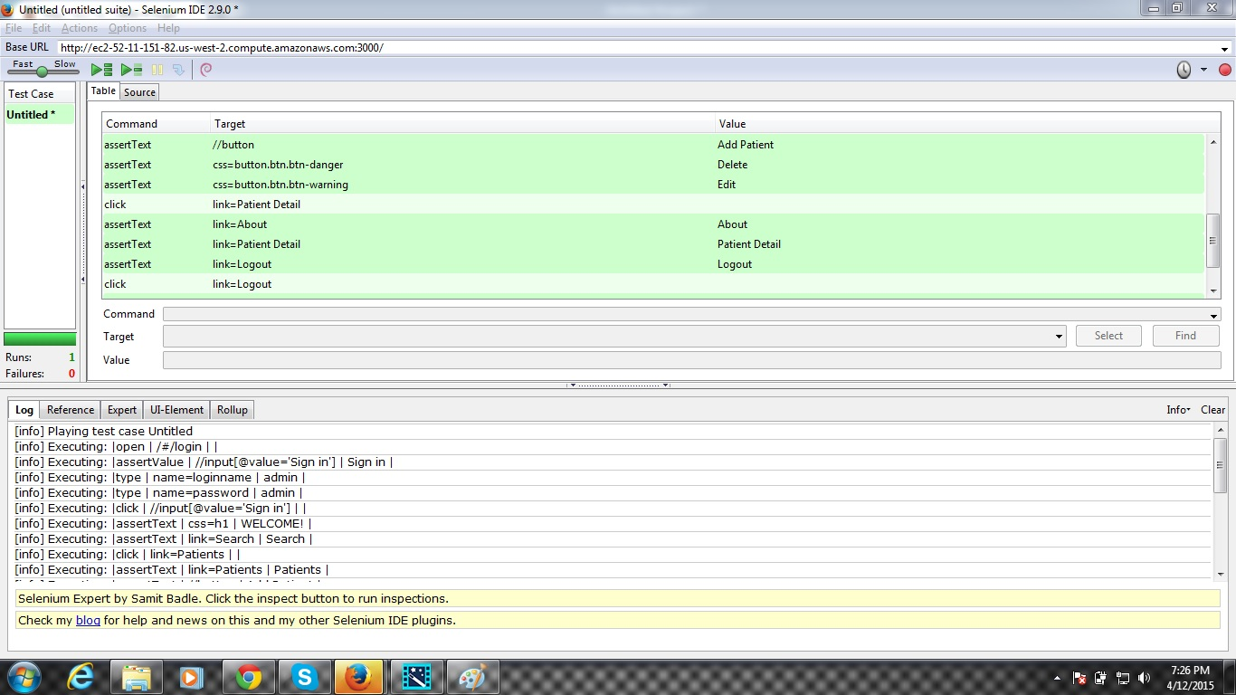

Slide 28
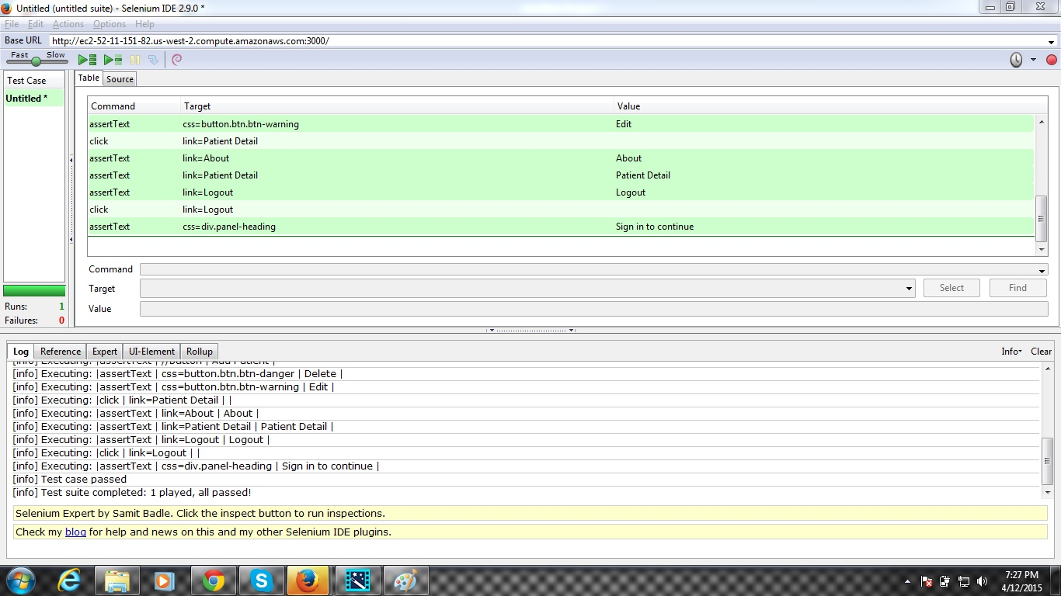

Slide 29
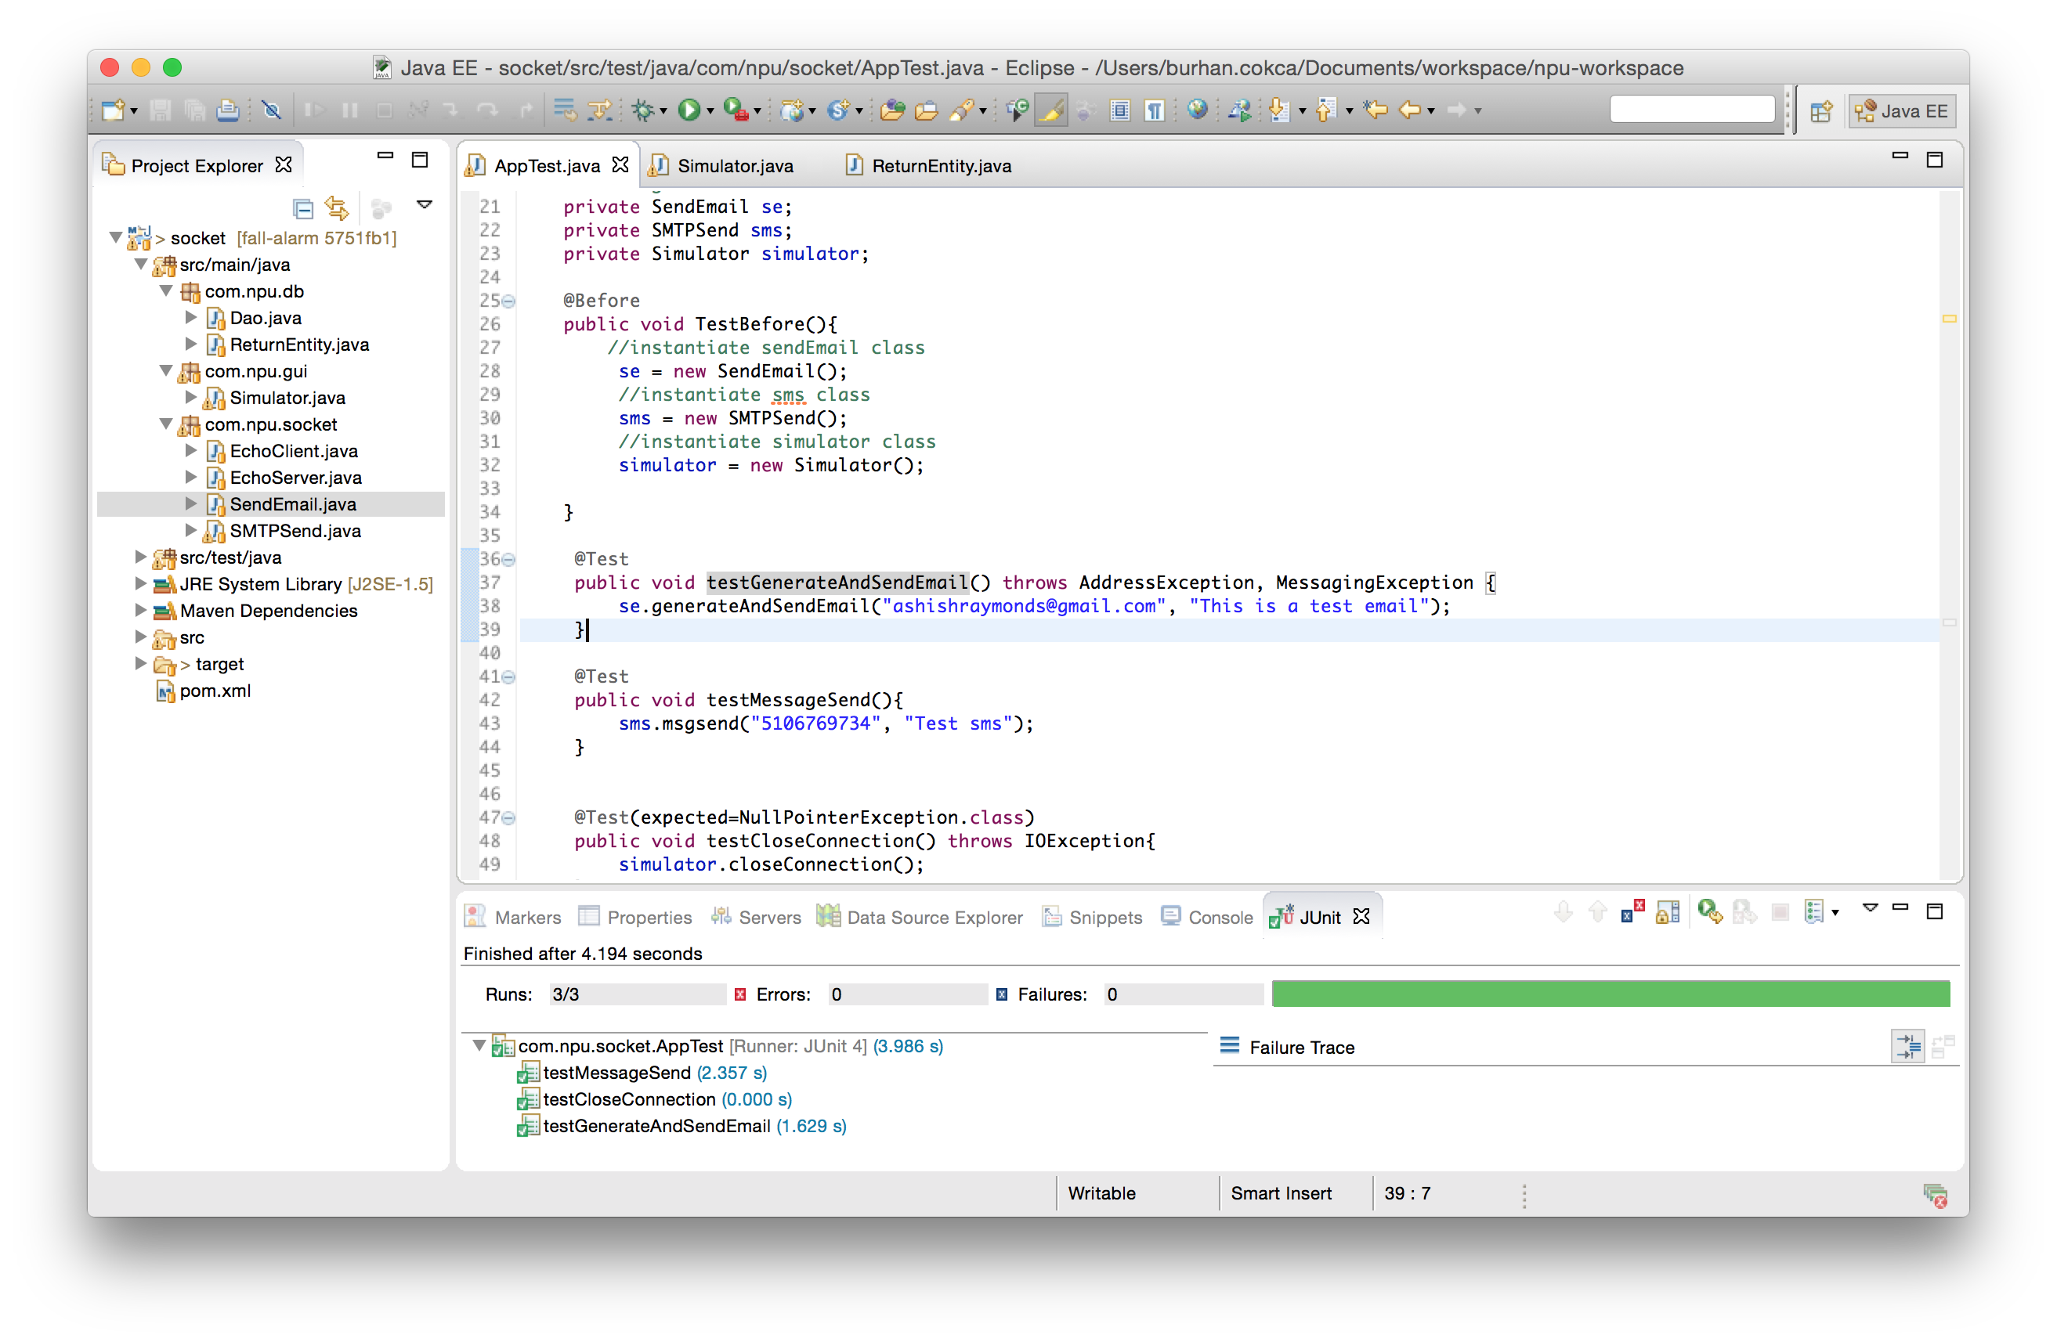

Slide 30
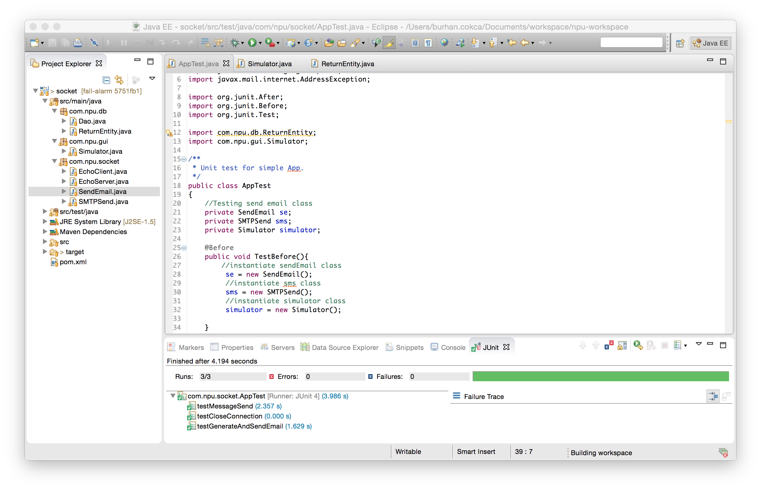

Slide 31
Q & A Thank you for listening

